Slide 1

Tree Traversal algorithms: In-order Pre-order and Post-order
Data Structure | Tree and Heap
Course: Data Structure | Chapter: Tree and Heap | Program: Bachelor of Engineering | Discover. Learn. Empower.
DISCOVER · LEARN · EMPOWER
Notes:
Welcome everyone to today's session on Tree Traversal algorithms. We will focus specifically on In-order, Pre-order, and Post-order traversals within the context of the Tree and Heap chapter. Remember, mastering these is essential for understanding how we access data in hierarchical structures efficiently.

Slide 2
Course Outcomes
SLIDE 2 / 14
Course Outcome
CO | BT LEVEL | DESCRIPTION
CO1 | BT1 | Understand and apply basic data structures, algorithms, complexity analysis, ADTs, arrays and linked lists.
CO2 | BT2 | Apply and implement stacks and queues in problem-solving.
CO3 | BT3 | Analyse and apply searching, sorting, and hashing techniques.
CO4 | BT4 | Construct and apply tree structures and traversal techniques.
CO5 | BT5 | Represent and solve graph problems using DFS, BFS, and graph algorithms.
Chandigarh University
2 / 14
Notes:
Today's lecture directly supports our Course Outcomes. CO2 is relevant because traversal algorithms often utilize stacks or queues internally to manage the nodes. CO3 is supported as these traversal methods are fundamental techniques for searching and processing tree-based data structures.

Slide 3
Learning Objectives
SLIDE 3 / 14
Learning Outcomes
1
Define the three primary tree traversal algorithms: In-order, Pre-order, and Post-order.
2
Explain the specific node visitation sequence for each traversal method clearly.
3
Demonstrate the recursive logic behind each traversal algorithm using a sample tree.
4
Differentiate the output sequences generated by In-order, Pre-order, and Post-order.
5
Identify common pitfalls when implementing these traversals in C programming code.
Chandigarh University
3 / 14
Notes:
By the end of this lecture, you will be able to define and distinguish between the three traversal types. We will walk through the exact sequence of visiting nodes for each method. You will also see a concrete example of how the output changes based on the traversal order chosen.

Slide 4
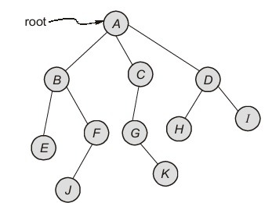
Lecture
SLIDE 4 / 14
What is Tree Traversal?
1
Tree traversal is the process of visiting every node in a tree exactly once.
2
Unlike linear structures, trees have multiple paths, requiring specific systematic rules.
3
The goal is to convert the hierarchical tree structure into a linear sequence.
4
Traversals are essential for operations like searching, sorting, and deleting nodes.
5
There are three main depth-first traversal methods: In-order, Pre-order, and Post-order.
6
Each method defines a unique order in which the root, left, and right subtrees are processed.
7
Understanding traversal is the foundation for implementing complex tree algorithms efficiently.
Tree - Abstract Data Type | MADE EASY
Chandigarh University
4 / 14
Notes:
Think of traversal as a systematic way to read a book where pages are arranged in a hierarchy. We must visit every single node without missing any or visiting any twice. This process converts our complex tree structure into a simple linear list that we can process further.

Slide 5
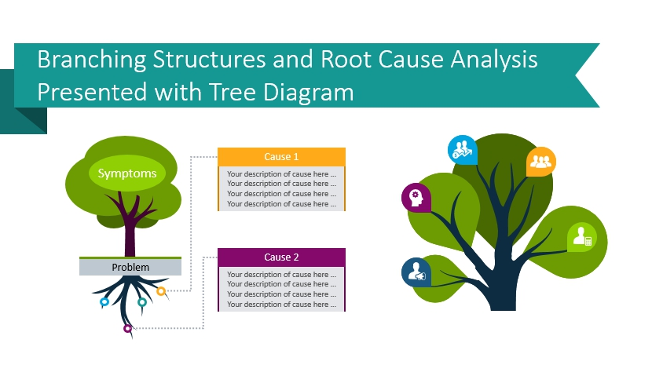
Lecture
SLIDE 5 / 14
Pre-order Traversal Logic
THE SEQUENCE IS STRICTLY
Root → Left Subtree → Right Subtree.
• Pre-order traversal visits the root node before its left and right subtrees.
• This method is useful for creating a copy of the tree structure.
• It is also used to generate prefix expressions from expression trees.
• The root is processed first, ensuring parent nodes are handled before children.
• Recursion is the most common implementation method for this traversal pattern.
• The first element in the output sequence is always the root of the tree.
Source: blog.infodiagram.com
Chandigarh University
5 / 14
Notes:
In Pre-order, we visit the root first, which is why it is called 'Pre'. Imagine you are introducing a family; you introduce the parent before the children. This order is crucial for serializing tree structures or creating prefix notation for mathematical expressions.

Slide 6
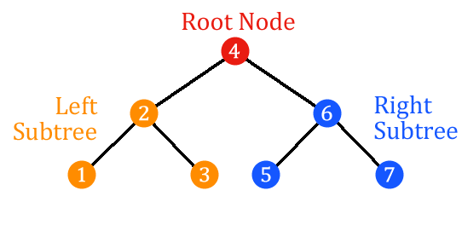
Lecture
SLIDE 6 / 14
In-order Traversal Logic
THE SEQUENCE IS STRICTLY
Left Subtree → Root → Right Subtree.
• In-order traversal visits the left subtree, then the root, then the right subtree.
• For Binary Search Trees, this traversal yields nodes in sorted ascending order.
• It is the standard method for evaluating infix expressions in expression trees.
• The root is processed only after all nodes in the left subtree are done.
• This method provides a natural sorted sequence for data stored in BSTs.
• It is widely used for converting expression trees into standard infix notation.
Source: raw.githubusercontent.com
Chandigarh University
6 / 14
Notes:
In-order is the most famous traversal because it sorts data in a Binary Search Tree. If you have a BST, walking through it in-order gives you the numbers from smallest to largest. This is why it is the go-to method for printing sorted data from a tree.

Slide 7
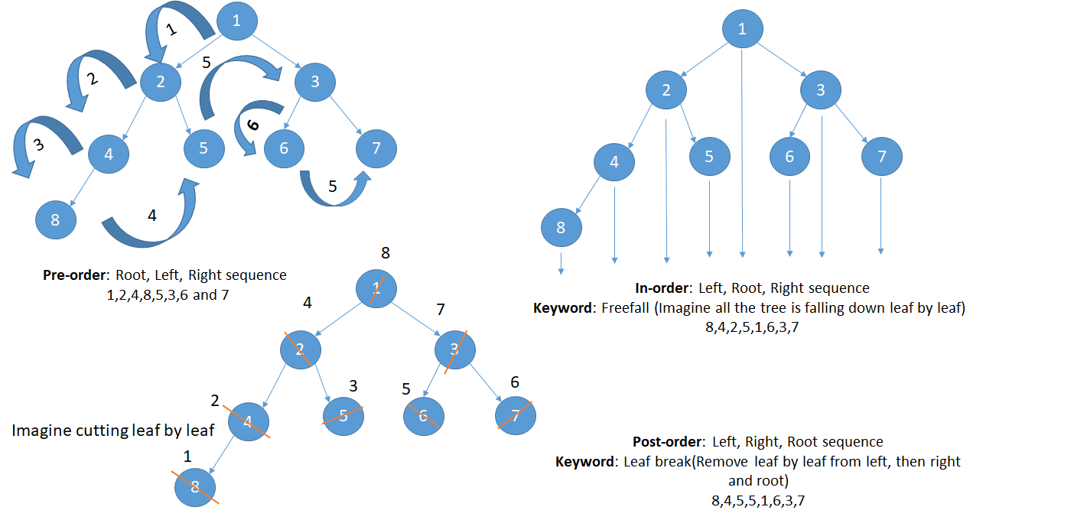
Lecture
SLIDE 7 / 14
Post-order Traversal Logic
THE SEQUENCE IS STRICTLY
Left Subtree → Right Subtree → Root.
• Post-order traversal visits the left subtree, then the right subtree, then the root.
• This method is ideal for deleting a tree because children are removed first.
• It is used to generate postfix expressions (Reverse Polish Notation) from trees.
• The root is processed last, ensuring all descendants are handled before the parent.
• It is essential for calculating the height or size of a tree recursively.
• The last element in the output sequence is always the root of the tree.
Source: sivakumarkumaravelu.wordpress.com
Chandigarh University
7 / 14
Notes:
In Post-order, we visit the root last, which is why it is called 'Post'. Think of it like cleaning up a room; you put away the toys (children) before you leave the room (root). This is perfect for deleting trees or calculating the total size of a subtree.

Slide 8
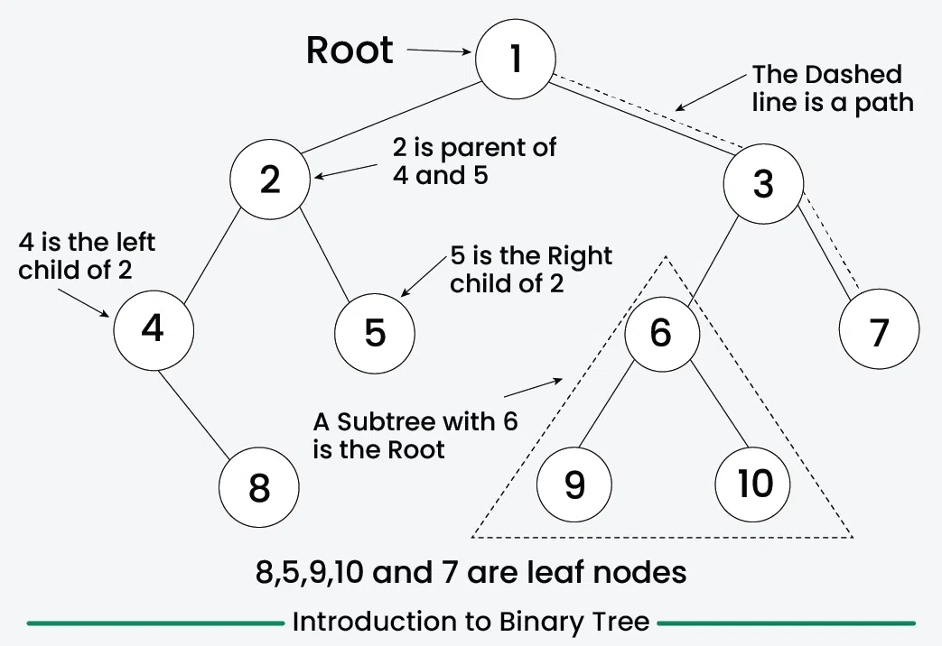
Worked Example
SLIDE 8 / 14
Pre-order
PRE-ORDER SEQUENCE
Visit Root 1 first.
THEN TRAVERSE LEFT SUBTREE
Visit 2, then 4, then 5.
FINALLY TRAVERSE RIGHT SUBTREE
Visit 3, then 6.
FINAL PRE-ORDER OUTPUT SEQUENCE
1, 2, 4, 5, 3, 6.
• Consider a tree with Root 1, Left child 2, Right child 3.
• Node 2 has children 4 (left) and 5 (right).
• Node 3 has a left child 6 and no right child.
Source: media.geeksforgeeks.org
Chandigarh University
8 / 14
Notes:
Let's trace this specific tree. We start at 1, then go left to 2. From 2, we go left to 4, then right to 5. Back at 1, we go right to 3, then to its left child 6. The sequence 1, 2, 4, 5, 3, 6 confirms the Root-Left-Right rule.

Slide 9
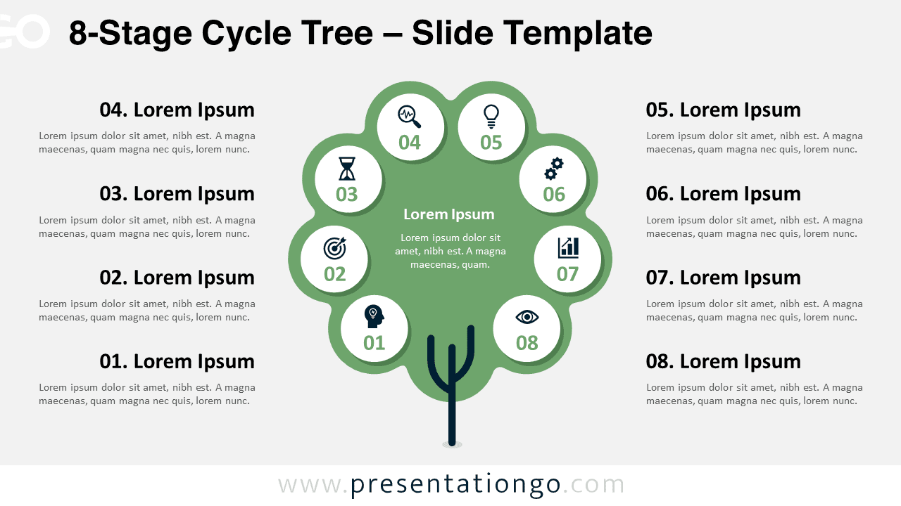
Worked Example
SLIDE 9 / 14
In-order
USING THE SAME TREE
Root 1, Left 2, Right 3.
IN-ORDER SEQUENCE
Traverse Left subtree of 1 first.
FINALLY TRAVERSE RIGHT SUBTREE
Visit 3's left child 6, then 3.
FINAL IN-ORDER OUTPUT SEQUENCE
4, 2, 5, 1, 6, 3.
• Node 2 has children 4 (left) and 5 (right).
• Node 3 has a left child 6.
• Visit 2, then its left child 4, then 2 itself, then right child 5.
• Visit Root 1.
Source: images.presentationgo.com
Chandigarh University
9 / 14
Notes:
Now let's apply In-order to the same tree. We go deep left to 4, then up to 2, then right to 5. Then we visit the root 1. Finally, we go to the right subtree, visiting 6 then 3. The sequence 4, 2, 5, 1, 6, 3 shows the Left-Root-Right pattern.

Slide 10
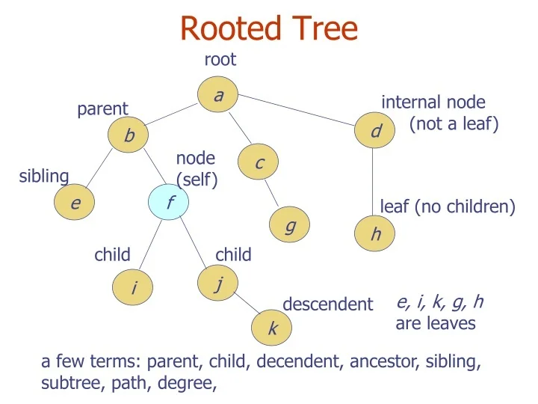
Worked Example
SLIDE 10 / 14
Post-order
USING THE SAME TREE
Root 1, Left 2, Right 3.
POST-ORDER SEQUENCE
Traverse Left subtree completely first.
THEN TRAVERSE RIGHT SUBTREE
Visit 6, then 3.
FINAL POST-ORDER OUTPUT SEQUENCE
4, 5, 2, 6, 3, 1.
• Node 2 has children 4 (left) and 5 (right).
• Node 3 has a left child 6.
• Visit 4, then 5, then 2.
• Finally visit Root 1.
Source: cdn5.slideserve.com
Chandigarh University
10 / 14
Notes:
Finally, let's do Post-order. We go all the way left to 4, then right to 5, then up to 2. Then we go to the right subtree, visiting 6 then 3. Only then do we visit the root 1. The sequence 4, 5, 2, 6, 3, 1 confirms the Left-Right-Root rule.

Slide 11
Lecture
SLIDE 11 / 14
Comparison of Traversal Outputs
1
Pre-order always starts with the root node of the tree.
2
In-order places the root node in the middle of the sequence.
3
Post-order always ends with the root node of the tree.
4
For a Binary Search Tree, only In-order produces a sorted list.
5
Pre-order is best for copying trees or prefix notation generation.
6
Post-order is best for deleting trees or postfix notation generation.
7
The choice of traversal depends entirely on the specific application requirement.
Chandigarh University
11 / 14
Notes:
Notice the distinct patterns. Pre-order starts with the root, In-order puts it in the middle, and Post-order ends with it. If you need to sort data, In-order is your only choice for a BST. If you need to delete, Post-order ensures children are gone before the parent.

Slide 12
Lecture
SLIDE 12 / 14
Common Pitfalls in Implementation
1
Confusing the order of recursive calls leads to incorrect output sequences.
2
Forgetting base cases (null nodes) causes infinite recursion or stack overflow.
3
Using iterative approaches without a stack or queue often leads to logic errors.
4
Assuming all trees are Binary Search Trees when they are not.
5
Not handling empty trees correctly can crash the program during execution.
6
Mixing up Pre-order and Post-order definitions is a frequent student error.
7
Ignoring the specific structure of the tree can lead to wrong traversal results.
Chandigarh University
12 / 14
Notes:
A common mistake is swapping the order of the recursive calls for left and right subtrees. Another major pitfall is forgetting the base case where the node is null, which stops the recursion. Always ensure your base case is checked before processing the node to prevent crashes.

Slide 13
Lecture
SLIDE 13 / 14
Key Takeaways
PRE-ORDER
Root → Left → Right; used for copying trees and prefix notation.
IN-ORDER
Left → Root → Right; used for sorting BSTs and infix notation.
POST-ORDER
Left → Right → Root; used for deleting trees and postfix notation.
• All three methods visit every node exactly once using depth-first search.
• The root node's position in the output sequence distinguishes the three methods.
• Correct implementation requires careful handling of recursive base cases.
Chandigarh University
13 / 14
Notes:
To summarize, remember the root's position: first for Pre-order, middle for In-order, and last for Post-order. Each method has a specific use case, from sorting data to deleting trees. Mastering these sequences is fundamental to your understanding of data structures.

Slide 14
Lecture
SLIDE 14 / 14
References
DATA STRUCTURES
A Pseudocode Approach with C — Gilberg, Forouzan
• Data Structures — Lipschutz
• Data Structure Using C — AK Sharma
• C and Data structure — P. S. Deshpandey
Chandigarh University
14 / 14
Notes:
These four books provide comprehensive coverage of tree data structures and traversal algorithms. I recommend Gilberg and Forouzan for a pseudocode approach, and Lipschutz for clear theoretical explanations. Please refer to these texts for further practice problems and detailed implementations.

